Slide 1
Decrease-and-Conquer
Natasha Dejdumrong.
CPE 212 Algorithm Design
Notes:
Reduce problem instance to smaller instance of the same problem.
Solve smaller instance
Extend solution of smaller instance to obtain solution to original instance

Slide 2

Topics
Decrase-by-a-constant
Insertion sort
Topological sorting
Generating permutations
Decrease-by-a-constant-factor
Binary search
Fake-coin problem
Variable-size decrease
Selection problem

Slide 3
Decrease by a constant
Decrease by a constant factor
Variable-size
decrease
Insertion sort
Topological sorting
Generating permutations
Binary search
Exponentiation
Multiplication
Euclid's
Selection by partition
Notes:
Reduce problem instance to smaller instance of the same problem.
Solve smaller instance
Extend solution of smaller instance to obtain solution to original instance
Find the relationship between problem size n-1 and problem size n
and explore the relationship bottom-up or top-down.

Slide 4
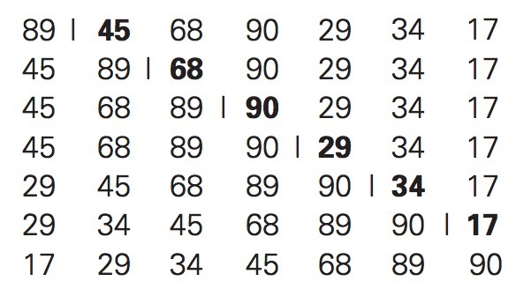
Insertion Sort
Take the leftmost item as already sorted
Successively put the leftmost item of the remaining portion to the sorted portion.
So, size of an instance decreased by a constant in each iteration.
Notes:
Size of each instance reduced by one in each iteration (normally one)
Assume that A[0 to n-2] has already been sorted.
We just find a place to insert A[n-1]
Explore this relationship bottom-up

Slide 5
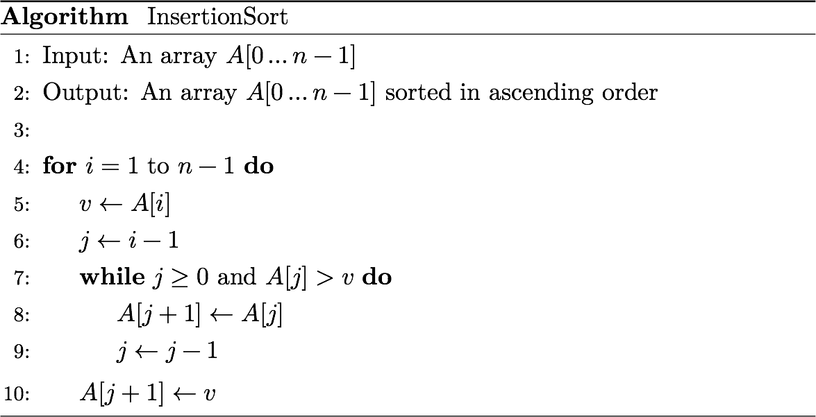
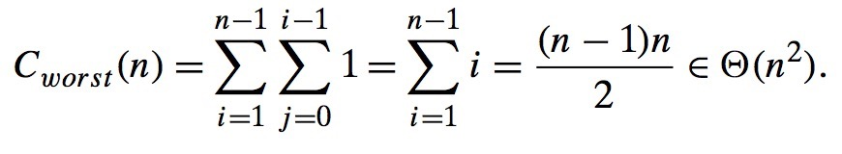
Notes:
Best case is Theta(n)
Average case C(n) ~ n^2/4
Standout among selection sort and bubble sort.

Slide 6
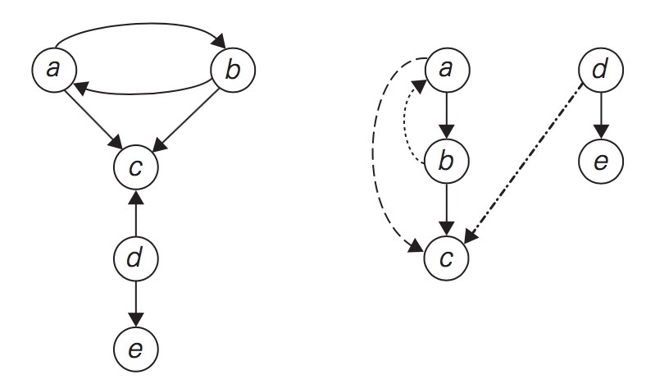
Directed Graph (Digraph)
Back
edge
Tree edge
Forward
edge
Cross
edge
Result from DFS traversal
Not Directed Acyclic Graph (DAG)

Slide 7
Directed Graph (Digraph)
a
d
Back
edge
Tree edge
Forward
edge
b
e
Cross
edge
c
Result from DFS traversal
Not Directed Acyclic Graph (DAG)
Notes:
Back edge = Edge connecting to one of its predecessor

Slide 8
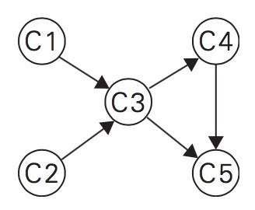
Topological Sorting Problem
Five courses {C1, C2, C3, C4, C5}
C3 requires C1 and C2 as prerequisites
C4 requires C3 as prerequisite
C5 requires C3 and C4 as prerequisites
Student can only take one course per semester.
What is the order to take the courses?
Notes:
Other forms of problem.
Construction/software project planning with lots of tasks
Manufacturing process
Allow for checking if the set of tasks have no conflict.

Slide 9
Solution to Topological Sorting
Can we list all the vertices such that, for every edge, the vertex where the edge starts is listed before the vertex where the edge ends?
First solution: Amount to checking if DFS traveral yields DAG (No back edge).
Notes:
Ex: C3 must not come before C1 and C2

Slide 10
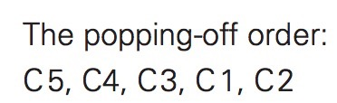
C1
C2
Cross
edge
C3
Forward
edge
C4
C5
DFS traversal
Directed Acyclic Graph (DAG)
Notes:
Why does it work?
When v popped off from the stack, no u with an edge from u to v can be among the vertices popped off before v. Or else (u,v) would have been a back edge.
So, any such vertex u will be listed after v in the pop-off order list, and before v in the reversed list.

Slide 11
Source Removal Algorithm
Decrease(by one)-and-Conquer approach
Repeatedly delete a vertex with no incoming edge and its outgoing edges.
The order in which the vertices are deleted yields a solution to the problem.
May yield different solution than DFS.
Notes:
Repeatedly delete a vertex with no incoming edge. Break-tie arbitraily.
Stop when no such vertex exists.
If algorithm terminates with no vertex left, a solution exists.

Slide 12
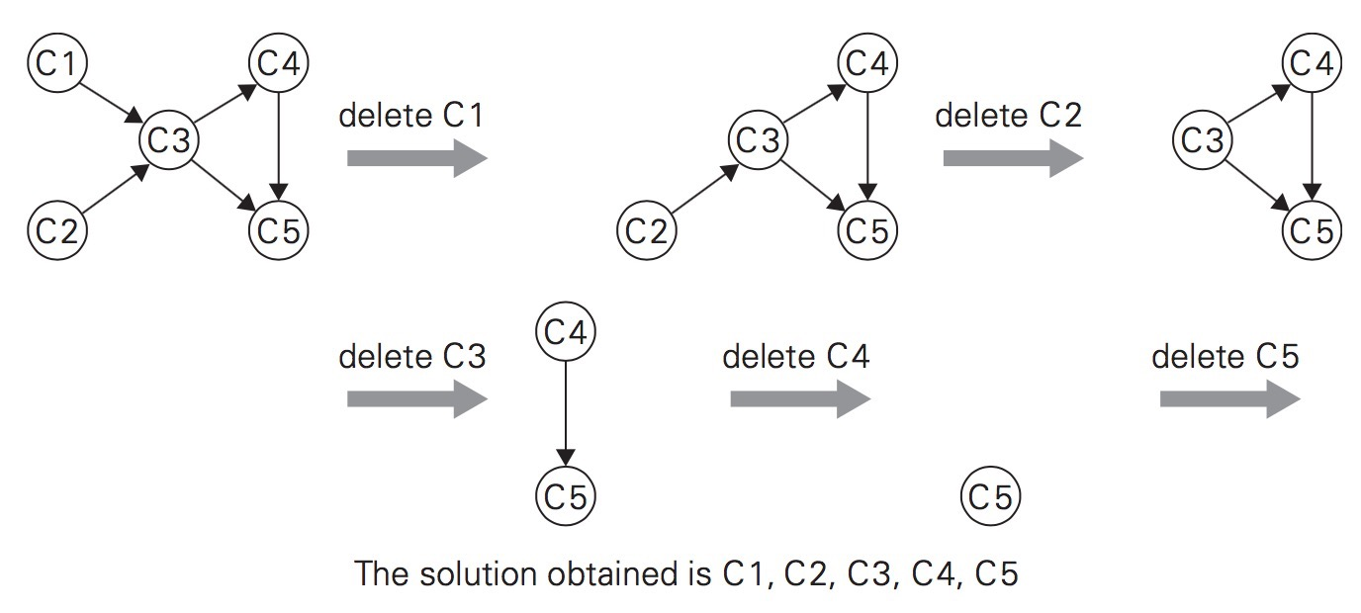

Slide 14
Generating Combinatorial Objects
Mostly used for brute-force and exhaustive search algorithms.
All sequences of cities in TSP
All combinations of objects in knapsack problem.
Three types
Permutations
Combinations
Subsets

Slide 15
Permutation
Ex:
How many ways to arrange letters a, b, c ?
How many ways to arrange six books on a shelf ?
Number of orders (sequences) of a selection of n distinct objects.
Called “Sampling without Replacement”
Notes:
Number of orders (sequences) of a selection of n distinct objects.
Number of permutations of n distinct objects = n!

Slide 16
k-Permutation
Ex:
Select three cards in succession from a deck of N cards. Each card is removed after being selected.
How many possible outcomes (a sequence of 3 distinct cards) ?
Number of sequences of k out of n distinct objects (1 · k · n).
Called “Ordered Sampling with Replacement”
Notes:
Number of permutations of n distinct objects
taken k at the time = n!/(n-k)! = Pn,k

Slide 17
Examples
A club has 25 members. The president and the secretary are to be chosen from the members. What is the total number of ways these two positions can be filled ?
Three awards (research, teaching, service) will be given one year for a class of 30 students. Each student can receive at most one award. How many possible selections ?
Notes:
1. 25*24 = 600
2. 30*29*28 = 24360
3. P_{n,k}/n^k

Slide 18
Combination
How many ways to choose two letters from {a,b,c,d} (order doesn’t matter) ?
# different selections (groups) of k objects from a set of n distinct objects
Called “Unordered sampling without replacement”
Form a group of 8 committees from 20 people. How many different groups can be formed ?
Notes:
Number of combinations of n objects
taken k at the time = Cn,k = Pn,k/k! = n!/(n-k)!k!

Slide 19
Generating Permutations
Ex: Consider a set of {a, b, c, d}
Generate all permutations of {a, b, c}
For each pattern, insert d at different positions to obtain the required patterns.
d a b c
a d b c
a b d c
a b c d
a b c
b c a
c a b
b a c
a c b
c b a
d c b a
c d b a
c b d a
c b a d
Notes:
4! = 4*3*2*1 = 24 patterns.

Slide 20
Assume a set of integers {1, 2, 3, …, n}
Can be interpreted as indices of an n-element set {a1, a2, …, an)
Totally n! permutations
Suppose we already have a pattern of single element {1}
How do we generate patterns with two elements 1 and 2?
Suppose we already have patterns of two elements {1, 2}, {2, 1}.
How do we generate patterns with three elements 1, 2, 3 ?

Slide 21
Decrease-by-One Technique
Remove one element and generate (n-1)! permutations
Inserting the removed element in all n possible positions of every permutations of n-1 elements.
Total permutations = n*(n-1)! = n!
(n-1)! permutations can be generated from (n-1)*(n-2)! and so on.

Slide 22
Start | 1
Insert 2 into 1 right to left | 1,2 | 2,1
Insert 3 into 1,2 | 1,2,3 | 1,3,2 | 3,1,2
Insert 3 into 2,1 | 2,1,3 | 2,3,1 | 3,2,1
Insert 4 into 1,2,3 | 1,2,3,4 | 1,2,4,3 | 1,4,2,3 | 4,1,2,3
Insert 4 into 1,3,2 | 1,3,2,4
Insert 4 into 3,1,2 | 3,1,2,4
Insert 4 into 3,2,1 | 2,1,3,4
Insert 4 into 2,3,1 | 2,3,1,4
Insert 4 into 2,1,3 | 3,2,1,4
Notes:
3,<1,2> —> 3,2,1
<3,2>,1 —> 2,3,1
2,<3,1> —> 2,1,3

Slide 23
Start | 1
Insert 2 into 1 right to left | 1,2 | 2,1
Insert 3 into 1,2 right to left | 1,2,3 | 1,3,2 | 3,1,2
Insert 3 into 2,1 right to left | 2,1,3 | 2,3,1 | 3,2,1
Insert new item from right to left and switch direction every time a new permutation needs to be processed.
Same as swapping two adjacent elements from right to left of the predecessor.
Start | 1
Insert 2 into 1 right to left | 1,2 | 2,1
Insert 3 into 1,2 right to left | 1,2,3 | 1,3,2 | 3,1,2
Insert 3 into 2,1 left to right | 3,2,1 | 2,3,1 | 2,1,3
Notes:
3,<1,2> —> 3,2,1
<3,2>,1 —> 2,3,1
2,<3,1> —> 2,1,3

Slide 24
Start | 1
Insert 2 into 1 right to left | 1,2 | 2,1
Insert 3 into 1,2 right to left | 1,2,3 | 1,3,2 | 3,1,2
Insert 3 into 2,1 left to right | 3,2,1 | 2,3,1 | 2,1,3
Insert 4 into 1,2,3 right to left | 1,2,3,4 | 1,2,4,3 | 1,4,2,3 | 4,1,2,3
Insert 4 into 1,3,2 left to right | 4,1,3,2 | 1,4,3,2 | 1,3,4,2 | 1,3,2,4
Insert 4 into 3,1,2 right to left | 3,1,2,4 | 3,1,4,2 | 3,4,1,2 | 4,3,1,2
Insert 4 into 3,2,1 left to right | 4,3,2,1 | 3,4,2,1 | 3,2,4,1 | 3,2,1,4
Insert 4 into 2,3,1 right to left | 2,3,1,4 | 2,3,4,1 | 2,4,3,1 | 4,2,3,1
Insert 4 into 2,1,3 left to right | 4,2,1,3 | 2,4,1,3 | 2,1,4,3 | 2,1,3,4
Satisfy the minimum-change requirement

Slide 25

Possible to generate n-element permutations without explicitly generating permutations for smaller values of n.
Consider one of the 4-element permutations:
An element said to be "mobile" if its arrow points to a smaller number adjacent to it.
4 is mobile while 3, 2, 1 are not.

Slide 26
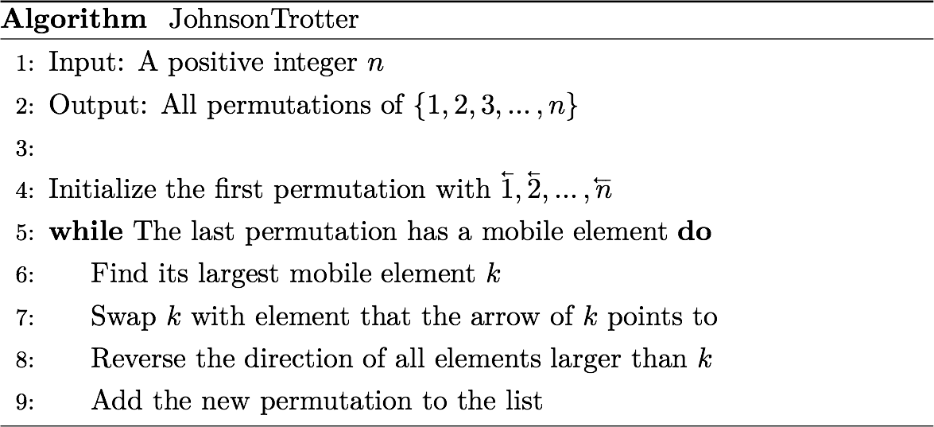


Slide 27
Generating All Subsets (Power Set)
Want to find all subsets of A = {a1, a2, …, an}, e.g., knapsack problem.
Subset of A = Set of whose all its members are also elements of A.
What are the subsets of A = {x, y, z} ?
Notes:
Still need to generate all power set of smaller sets.
Starting from an empty, successively add one element to all the former set.

Slide 28
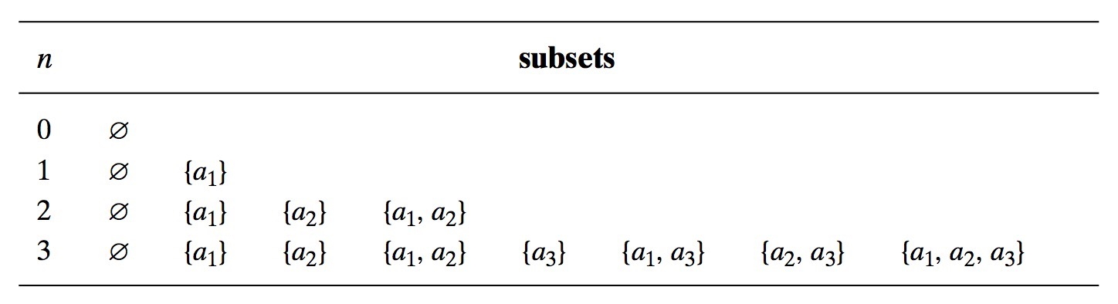
Decrease-by-one approach
All subsets of A = {those without an} ∪ {those with an}
The former group is all subsets of A = {a1, a2, …, an-1}
The latter group is the former added by {an}

Slide 29
Easier way is to use an n-bit bit string to represent presence or absence of individual elements

Slide 30
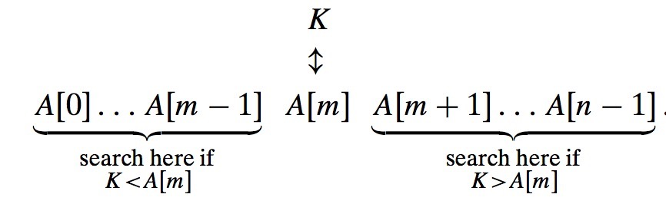
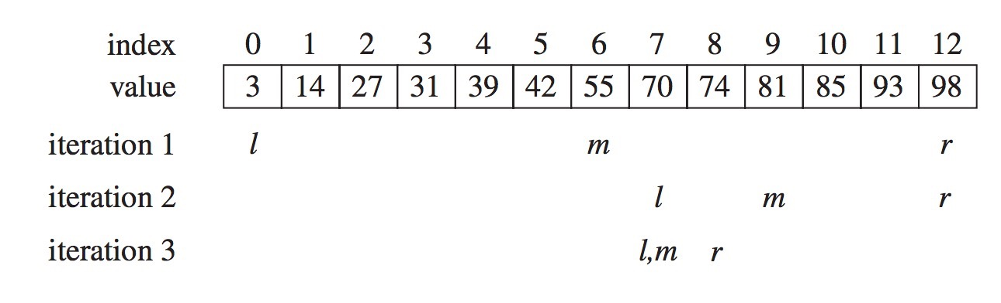
Binary Search
Decrease-by-a-constant factor search algorithm operated on a sorted list.
Notes:
Search for K = 70

Slide 31
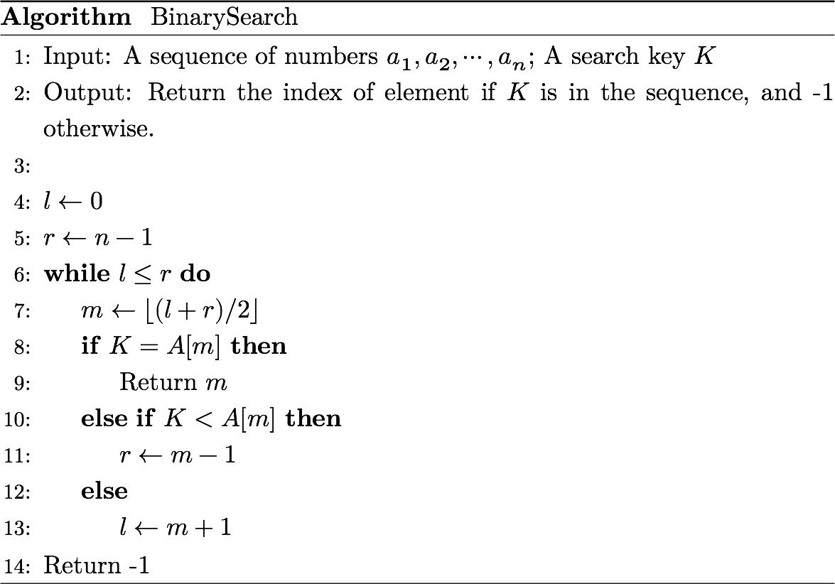

Slide 32

Efficiency of Binary Search
Worst case when the search key is not in the list.
After one comparison, the array size to search is reduced by half. So,
Assume that n = 2^{k}, solving the above recurrence equation with backward substitution results in
Notes:
C(2^k) = C(2^{k-1}) + 1
= (C(2^{k-2}) + 1) + 1
= (C(2^{k-3}) + 1) + 1 + 1
= (C(2^{k-k}) + k = 1+k

Slide 33
Fake-Coin Problem
A set of n identical-looking coins, one of which is fake.
How to find it?
Assume the fake one is lighter.
Fake coin has unknown weight for the harder version
Notes:
Not the most efficient algorithm as we can divide the coins into three piles

Slide 34
Inefficient solution: Compare two coins one by one.
More efficient solution
Divide n coin into two halfs (leave extra one aside if not even)
Put two piles on the balance scale. The lighter one contains the fake coin. What if two piles weight equal?
Repeat the division into half like binary search.
Notes:
Log2(n) for two piles
Log3(n) for three piles
Not the most efficient algorithm as we can divide the coins into three piles

Slide 35
Number of weightings W(n) needed by the algorithm is
What is the efficiency of this algorithm?
Can we do it by dividing into three piles instead of two
What if Pile 1 = Pile 2?
What if Pile 1 > Pile 2?
What if Pile 1 < Pile 2?
Notes:
1 = Weighting to compare two piles
W[n/2] = Weighting for individual piles of n/2
floor[Log2(n)) for two piles
floor(Log3(n)) for three piles
Not the most efficient algorithm as we can divide the coins into three piles
- 1 = 2 means 3 has fake coin
- 1 > 2 means 2 has fake coin
- 1 < 2 means 1 has fake coin

Slide 36

Josephus Problem
Fortress of Jotapata

Slide 37
The Selection Problem
Find k^{th} smallest element in a list of n numbers (k^{th} order statistic)
k = 1: Smallest element
k = n: Largest element
k = ceil(n/2): Median (most of interest)
What is the median of the list {4,1,10,8,7,12,9,2,15}?
Straightforward approach with sorting but overkill
Notes:
Sorting is overkill b/c we are asked to find the kth smallest, not sort the list.

Slide 38
Suppose we have a list {4, 1, 10, 8, 7, 12, 9, 2, 15} that we want to find the 5th-order statistic.
Choose "4" as the pivot element to partition the list into three segments:
The 5th-order statistic of the original list must be in the ________ segment as the _____ -order statistic.
Left segment
Right segment
all values < 4
4
all values ≥ 4
Two values in here
(positions 0,1}
position
s=2
Six values in here
(positions 3,4,5,6,7,8}
Notes:
Right
k-(s+1) = 5-(2+1)= 2-th order statistic

Slide 39
Suppose we have a list {8, 1, 10, 4, 7, 12, 9, 2, 15} that we want to find the 5th-order statistic.
Choose "8" as the pivot element to partition the list into three segments:
The 5th-order statistic of the original list must be ____
Left segment
Right segment
all values < 8
8
all values ≥ 8
Four values in here
(positions 0,1,2,3}
position
s=4
Four values in here
(positions 5,6,7,8}
Notes:
Right
k-(s+1) = 5-(2+1)= 2-th order statistic

Slide 40
Suppose we have a list {12, 1, 10, 8, 7, 4, 9, 2, 15} that we want to find the 5th-order statistic.
Choose "12" as the pivot element to partition the list into three segments:
The 5th-order statistic of the original list must in the ________ segment as the _____ -order statistic.
Left segment
Right segment
all values < 12
12
all values ≥ 12
Seven values in here
(positions 0,1,2,3,4,5,6}
position
s=7
One value in here
(position 8}
Notes:
Left
5-th order statistic

Slide 41
Suppose we can partition an original list in three segments based on a pivot value p shown below:
Three scenarios can happen
p is at position s = k-1
p is in the position s > k-1
p is in the position s < k-1
0 1 2 3 … n-1
all are < p
p
all are ≥ p
0 1 2 … k-1
all are < p
p
all are ≥ p
0 1 2 … k-1
all are < p
p
all are ≥ p
0 1 2 …..… k-1
all are < p
p
all are ≥ p
Notes:
1st case: p is the kth-order statistic
2nd case: kth-order statistics must be in the left segment (<= p)
3rd case: kth-order statistics must be in the right segment (>= p) as the (k-s-1)th order statistic

Slide 42
Lomuto Partitioning
Take a pivot value p
Partition the list so that
Left part contains all elements less than p.
Right part contains all elements greater than equal to p.
all are < p
p
all are ≥ p

Slide 43
List explored from left to right
s
i
p
< p
≥ p
x
Unexplored
If A[i] ≥ p, just increment i, which will expand the ≥ p segment.
s
i
p
< p
≥ p
x
Unexplored
Notes:
s = last position containing element < p

Slide 44
List explored from left to right
s
i
p
< p
≥ p
x
Unexplored
If A[i] < p,
increment s and swap A[s] with A[i], which will expand the <p segment.
increment i
s
i
p
< p
≥ p
x
Unexplored
s
i
p
< p
x
≥ p
Unexplored

Slide 45
When all elements are explored,
swap
s
i
p
< p
≥ p
< p
p
≥ p

Slide 46
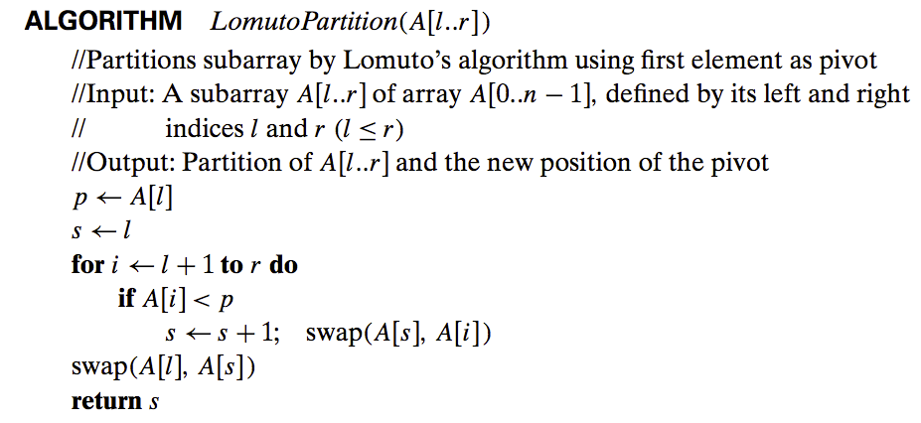

Slide 47
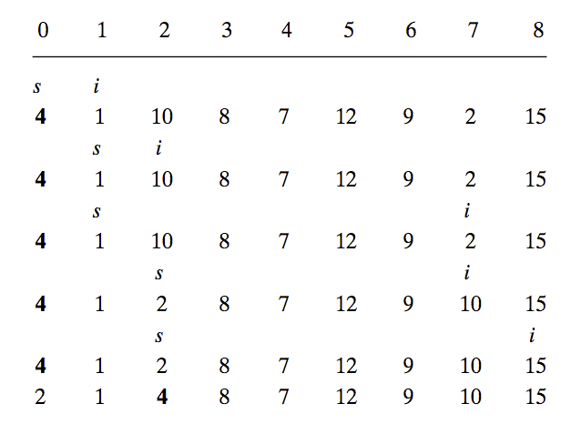
Find the 5th order statistic
`
`
`
New order is k - (s+1) = 5 - (2+1) = 2

Slide 48
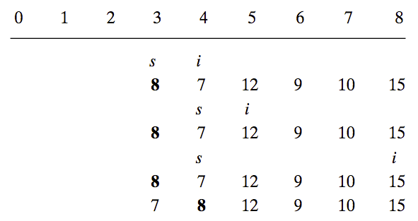

Slide 49
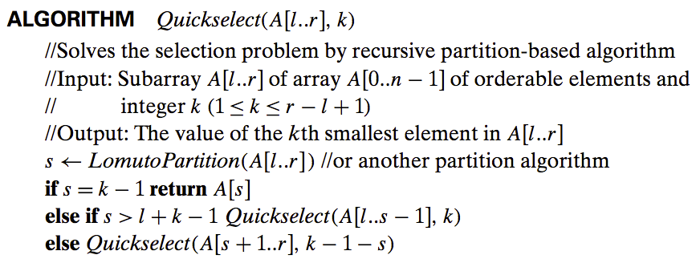
Also identify k smallest
and n-k largest elements as by product.

Slide 50
Efficiency of Quick Select
Partition an n-element array requires n-1 key comparisons.
Best case if the split solves the problem or Cbest(n) = n-1 ∈ Θ(n)
Worst-case if k = n and the array is strictly increasing
Ex: Finding 9th-order statistic in {1,2,4,7,8,9,10,12,15} needs n-1 partitions
Average case about log2(n) like binary search.

Slide 51
Summary
Reduce problem instance to smaller instance of the same problem.
Solve smaller instance
Extend solution of smaller instance to obtain solution to original instance
Notes:
Find relationship between a solution to a problem instance and that of a smaller instance.
Exploit the relationship top-down or bottom-up
Three variations
Decrease-by-one
Decrease-by-constant-factor
Variable-size-decrease

Slide 52
Summary
Find relationship between a solution to a problem instance and that of a smaller instance.
Exploit the relationship top-down or bottom-up
Three variations
Decrease-by-one
Decrease-by-constant-factor
Variable-size-decrease
Notes:
based on exploiting a relationship between a solution to a given instance of a problem and a solution to a smaller instance of the same problem. Once such a relationship is established, it can be exploited either top down (usually recursively) or bottom up.
Can be implemented either top-down or bottom-up
Also referred to as inductive or incremental approach

